Slide 1
AWT
Events and Event Delegation model&EventHandling

Slide 2
Window Application
class TempConverter extends Frame {
TempConverter(){
super(“Temp Converter");
setSize(300,300);
setVisible(true);
setLocation(500,200);
}
}

Slide 3
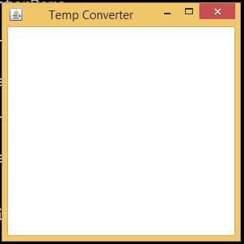
Window Application

Slide 4
Window Application-add controls
When adding controls, we should specify the layout in which the controls are to be added to the Frame window which is a container.
FlowLayout fl=new FlowLayout();
setLayout(fl);
or
setLayout(new FlowLayout());
adds controls in left to right top to bottom order.

Slide 5
Window Application-add controls
Add labels, textfields and buttons to the frame window.
Declare the fields, create objects and add.
Label lblFt,lblC;
TextField txtF, txtC;
Button btnConvert,btnClr;

Slide 6
Window Application-add controls
lblFt=new Label(“Fahrenheit”);
lblC=new Label(“Celcius”);
txtF=new TextField(20);
txtC=new TextField(20);
btnConvert=new Button(“Convert”);
btnClr=new Button(“Clear”);

Slide 7
Window Application-add controls
add(lblFt);
add(txtF);
add(lblC);
add(txtC);
add(btnConvert);
add(btnClr);

Slide 8
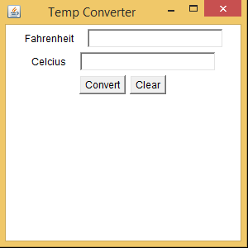
Window Application-add controls

Slide 9
Events
Window Closed
Different events like window closed, button clicked, mouse clicked, mouse moved may take place in a window.
How to handle these events in a meaningful way specific to that window?
Button Clicked

Slide 10
Event Delegate Model
Design a class whose objects are capable of handling events like window events, mouse events, action events, etc.
The class should implement an appropriate Listener interface available in java.awt.event

Slide 11
Event Delegate Model
The different interfaces are: WindowListener
ActionListener
MouseListener
MouseMotionListener,..
The class should implement all the methods in the interface.

Slide 12
Event Delegate Model
Create an object of that class and register it with the frame window as the event handler.

Slide 13
Event Delegate Model
class WEHandler implements WindowListener{
public void windowDeactivated(WindowEvent e){}
public void windowActivated(WindowEvent e){}
public void windowDeiconified(WindowEvent e){}
public void windowIconified(WindowEvent e){}
public void windowClosed(WindowEvent e){}
public void windowOpened(WindowEvent e){}
public void windowClosing(WindowEvent e){ System.exit(0);
}
}

Slide 14
Event Delegate Model
class TempConverter extends Frame {
WEHandler wh;
TempConverter(){
super(“Temp Converter");
setSize(300,300);
setVisible(true);
setLocation(500,200);
.
.
wh=new WEHandler();
addWindowListener(wh);
}
}

Slide 15
Event Delegate Model
addWindowListener(wh);
WEHandler wh
public void windowDeactivated(WindowEvent e){}
public void windowActivated(WindowEvent e){}
public void windowDeiconified(WindowEvent e){}
public void windowIconified(WindowEvent e){}
public void windowClosed(WindowEvent e){}public void windowOpened(WindowEvent e){}
public void windowClosing(WindowEvent e){ System.exit(0);
}

Slide 16
Event Delegate Model
addWindowListener(wh);
WEHandler wh
Window Closed
public void windowDeactivated(WindowEvent e){}
public void windowActivated(WindowEvent e){}
public void windowDeiconified(WindowEvent e){}
public void windowIconified(WindowEvent e){}
public void windowClosed(WindowEvent e){}public void windowOpened(WindowEvent e){}
public void windowClosing(WindowEvent e){ System.exit(0);
}

Slide 17
Event Delegate Model
addWindowListener(wh);
WEHandler wh
Window Closed
public void windowDeactivated(WindowEvent e){}
public void windowActivated(WindowEvent e){}
public void windowDeiconified(WindowEvent e){}
public void windowIconified(WindowEvent e){}
public void windowClosed(WindowEvent e){}public void windowOpened(WindowEvent e){}
public void windowClosing(WindowEvent e){ System.exit(0);
}
Event handling loop recognizes the event, notifies the listener object by invoking the appropriate event handling method. The details related to the event are

